Slide 1
RISK FACTORS PREDICTION FOR CARDIOVASCULAR HEART DISEASE
Using Machine Learning In Python
Project Mentor :
Prof. Arnab Chakraborty
Team Members
AGNISIS DUTTA
SHILPI SEN

Slide 2
CONTENTS
Project Objective & Scope
Data Description
Methodology
Data Preprocessing
Models Used
Accuracy Comparison
Future Scope of Improvements

Slide 3
Project objective & scope
Objective:
The classification goal is to predict whether the patient has a 10-year risk of future coronary heart disease (CHD) considering the other features.
The objectives of the Framingham Study are to study the incidence and prevalence of cardiovascular disease (CVD) and its risk factors, trends in CVD incidence and its risk factors over time, and familial patterns of CVD and risk factors.
Other important objectives include the estimation of incidence rates of disease and description of the natural history of cardiovascular disease, including the sequence of clinical signs and systems that precede the clinically recognizable syndrome and the consequences and course of clinically manifest disease.

Slide 4
Cardiovascular diseases (CVDs) are the leading cause of death globally, taking an estimated 17.9 million people died from CVDs in 2019, representing 32% of all global deaths. Of these deaths, 85% were due to heart attack and stroke.
More than four out of five CVD deaths are due to heart attacks and strokes, and one third of these deaths occur prematurely in people under 70 years of age.
The most important behavioural risk factors of heart disease and stroke are unhealthy diet, physical inactivity, tobacco use and harmful use of alcohol.
Over three quarters of CVD deaths take place in low- and middle-income countries.

Slide 5
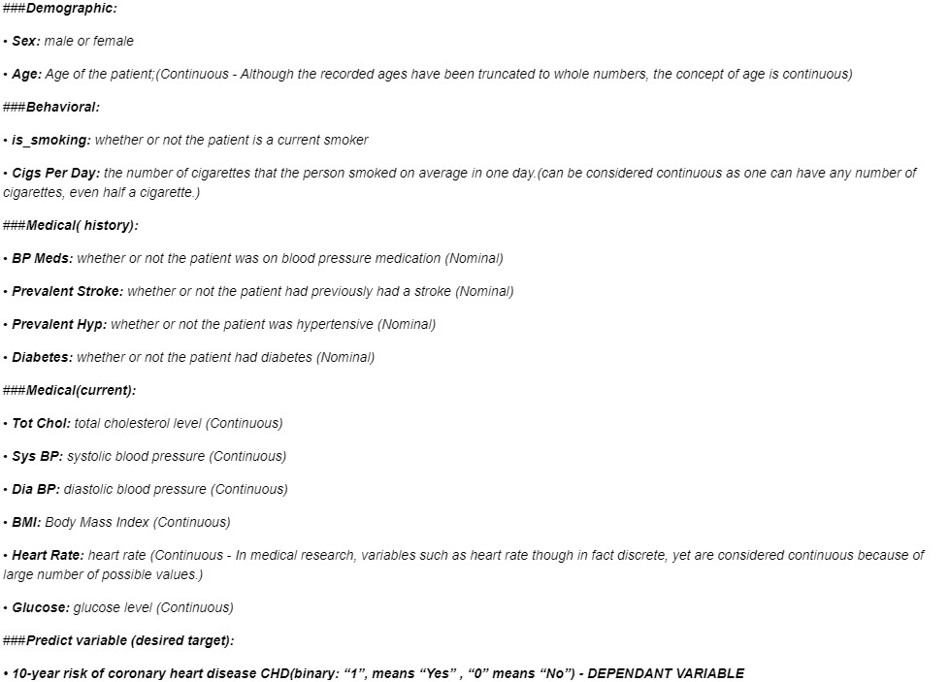
Data description
The description of the data with type and description of each Attribute is given/shown in the table.

Slide 6
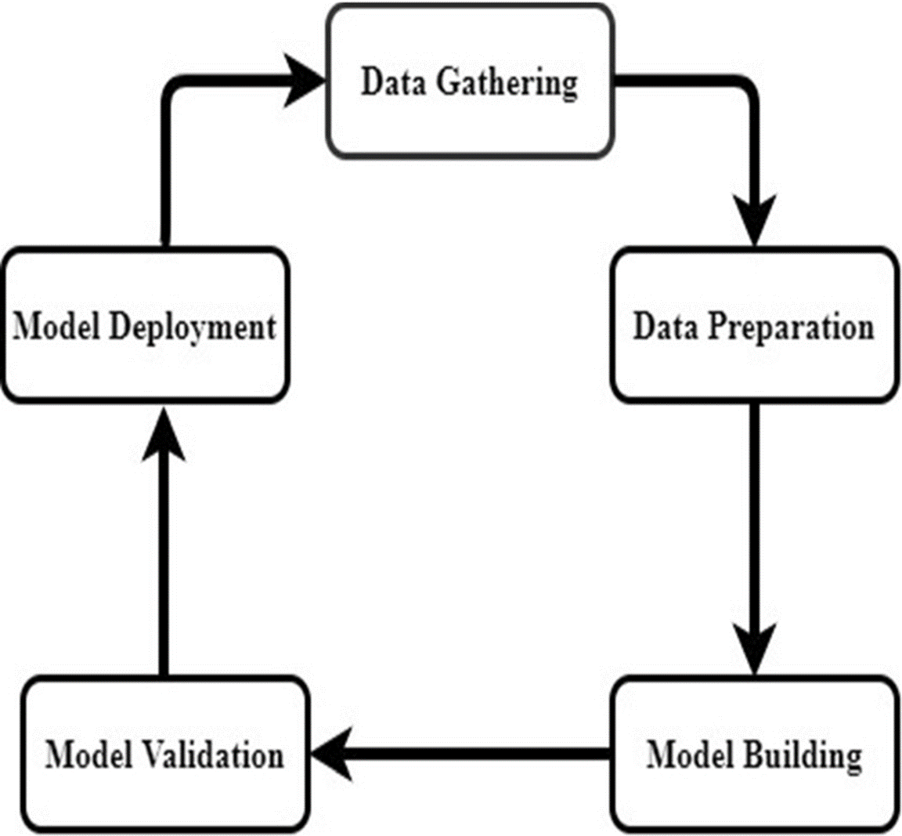
Methodology

Slide 7
Data Preprocessing & EDA
Exploratory data analysis or commonly known as EDA helps to explore data, and possibly formulate hypotheses that might cause new data collection and experiments. EDA build a robust understanding of the data, issues associated with either the info or process. it’s a scientific approach to get the story of the data.
It focuses more narrowly on checking assumptions required for model fitting and hypothesis testing. It also helps while handling missing values and making transformations of variables as needed.

Slide 8
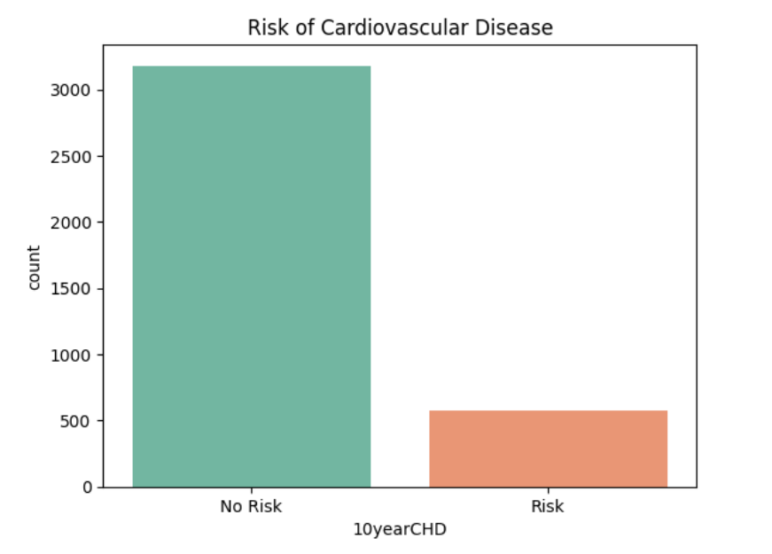
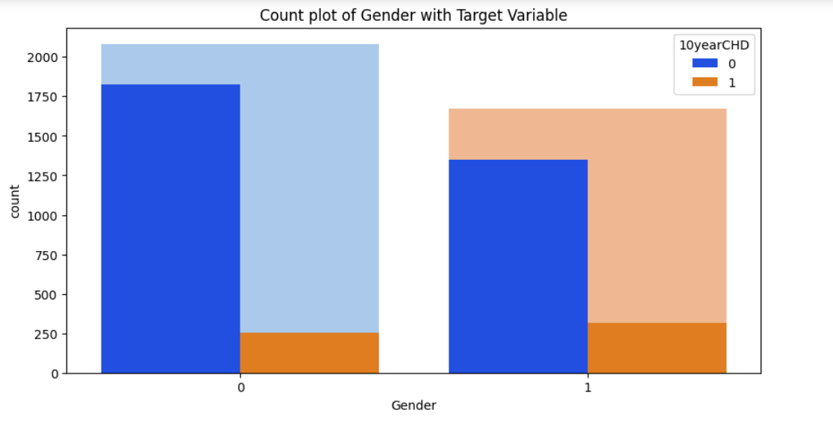
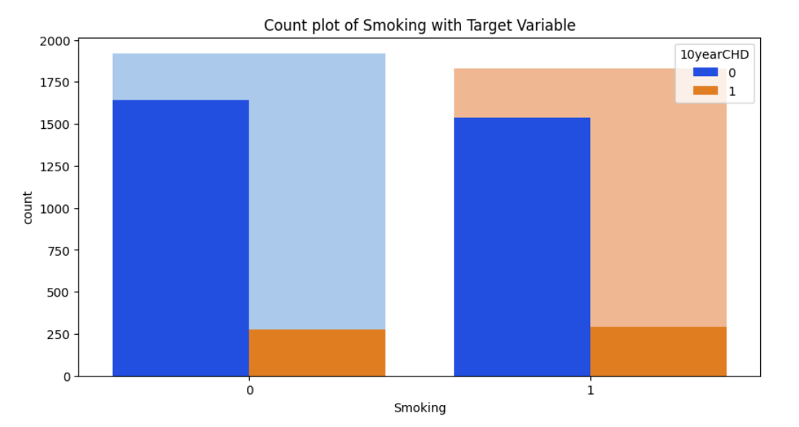
Univariate Analysis of Categorical Features & relation with Target Variable

Slide 9
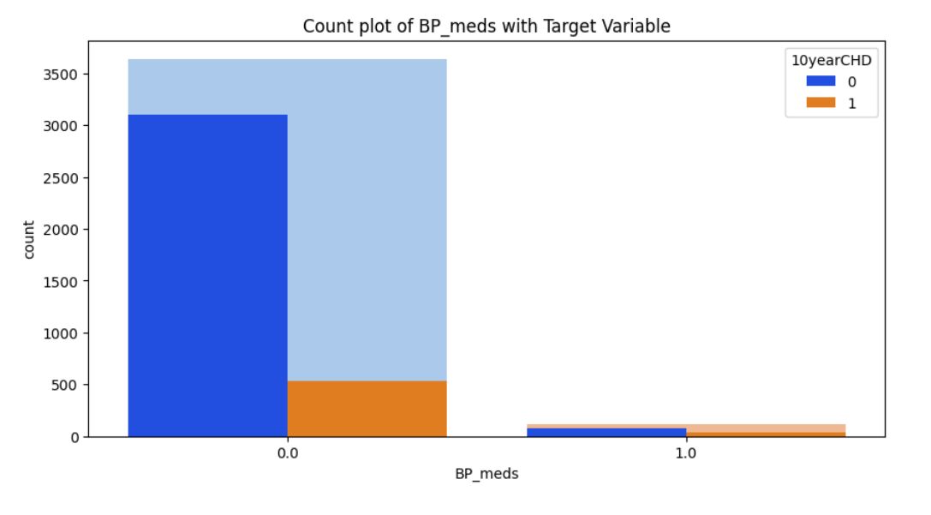
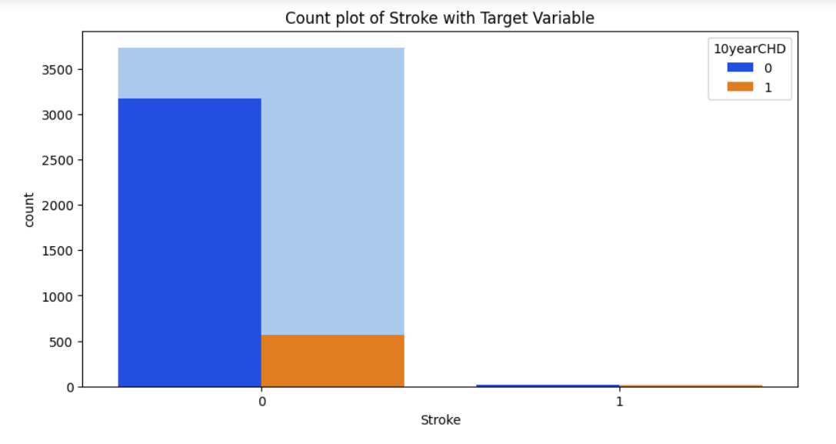
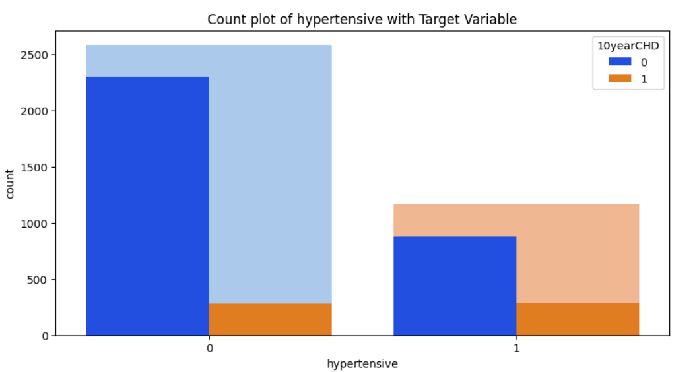
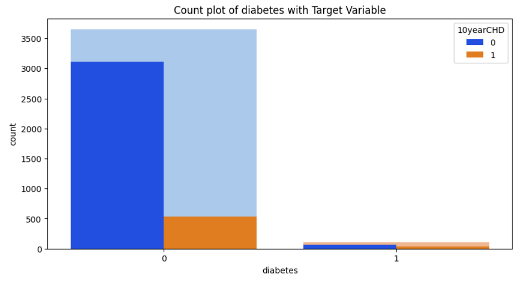

Slide 10
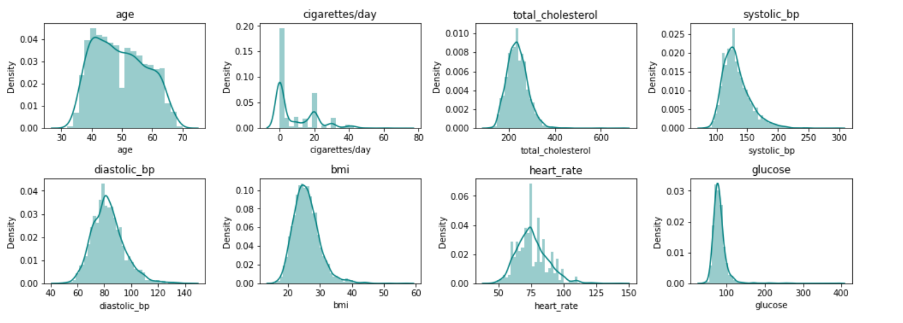
Univariate Analysis of Numerical Features

Slide 11
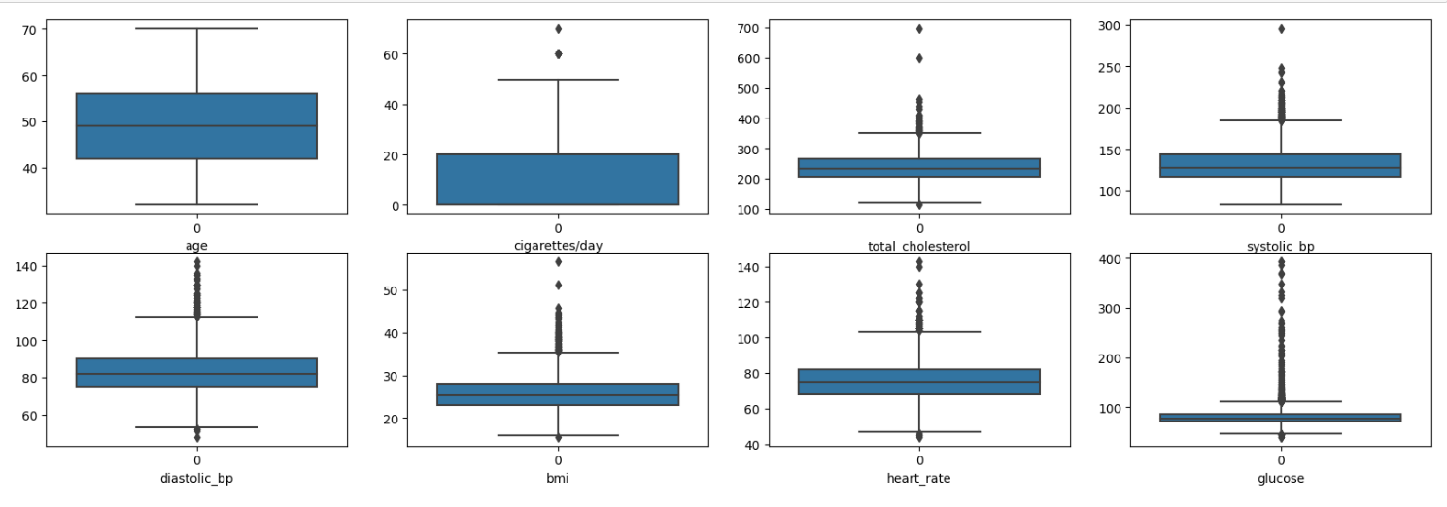
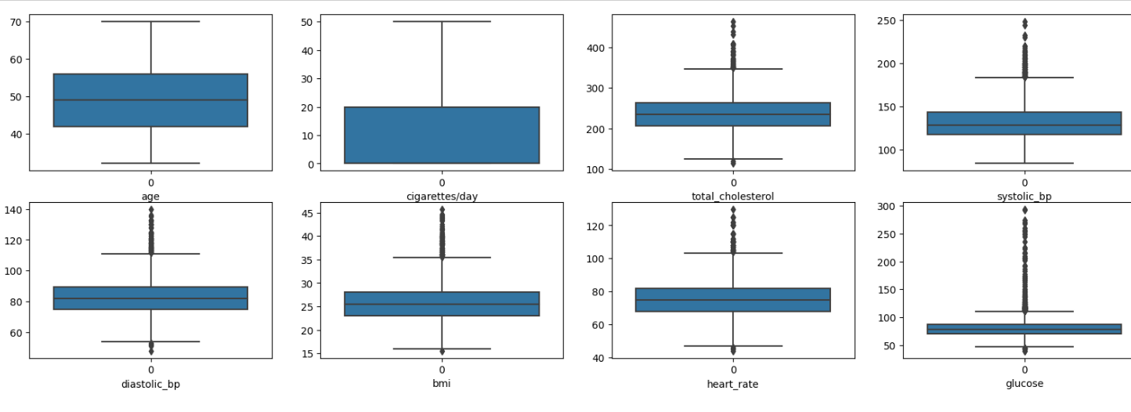
Outlier Detection of Numerical Features
BEFORE
AFTER

Slide 12
MODEL USED
The Machine Learning models used for this project are:
Naive Bayes ( Gaussian )
K – NN Classification
Regression ( Logistic )
Decision Tree
Random Forest
Support Vector Machine

Slide 13
Naive Bayes
KNN Classification
Principle of Naive Bayes Classifier :
A Naive Bayes classifier is a probabilistic machine learning model that’s used for classification task. The crux of the classifier is based on the Bayes theorem.
Bayes Theorem:
To find the probability of A happening, given that B has occurred.
A k-nearest-neighbor algorithm, often abbreviated k-nn, is an approach to data classification that estimates how likely a data point is to be a member of one group or the other depending on what group the data points nearest to it are in.
The k-nearest-neighbor is an example of a "lazy learner" algorithm, meaning that it does not build a model using the training set until a query of the data set is performed.
Gaussian Naive Bayes:
When the predictors take up a continuous value and are not discrete, we assume that these values are sampled from a gaussian distribution.

Slide 14
Logistic regression
Decision tree
Logistic Regression is the appropriate regression analysis to conduct when the dependent variable is dichotomous (binary). Like all regression analyses, the logistic regression is a predictive analysis.
Logistic regression is used to describe data and to explain the relationship between one dependent binary variable and one or more nominal, ordinal, interval or ratio level independent variables.
A decision tree is a graphical representation of specific decision situations that are used when complex branching occurs in a structured decision process. A decision tree is a predictive model based on a branching series of Boolean tests that use specific facts to make more generalized conclusions.
The main components of a decision tree involve decision points represented by nodes, actions and specific choices from a decision point. Each rule within a decision tree is represented by tracing a series of paths from root to node to the next node and so on until an action is reached.

Slide 15
Random Forest Classifier
Support Vector Machine
Random Forest is a technique that uses ensemble learning, that combines many weak classifiers to provide solutions to complex problems.
As the name suggests random forest consists of many decision trees. Rather than depending on one tree it takes the prediction from each tree and based on the majority votes of predictions, predicts the final output.
Random forests use the bagging method. It creates a subset of the original dataset, and the final output is based on majority ranking and hence the problem of overfitting is taken care of.
SVM is a powerful supervised algorithm that works best on smaller datasets but on complex ones. Support Vector Machine, abbreviated as SVM can be used for both regression and classification tasks, but generally, they work best in classification problems.
Support Vectors: These are the points that are closest to the hyperplane. A separating line will be defined with the help of these data points.
Margin: it is the distance between the hyperplane and the observations closest to the hyperplane (support vectors). In SVM large margin is considered a good margin. There are two types of margins hard margin and soft margin.

Slide 16
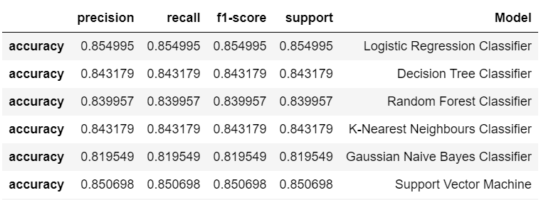
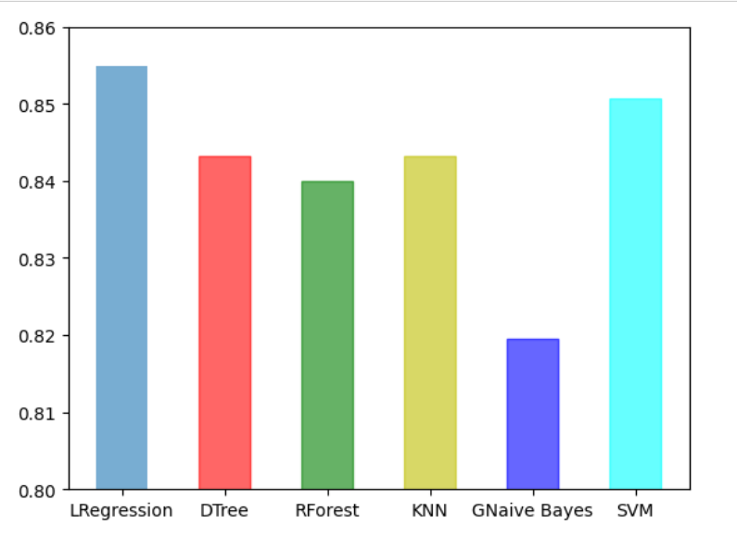
Model and accuracy comparison

Slide 17
Future scope of improvements
The dataset can be trained using more no of different algorithms to get higher accuracy.
Cross-validation can improve the over all train test splitting.
Null values can be determined and replaced by mean median or mode or any other suitable methods.
A larger dataset can be more beneficial for the model training.

Slide 18
Thank You

